Slide 1
FINAL YEAR PROJECT I & II (psm1 & psm2) BACHELOR OF COMPUTER SCIENCE (NETWORKING)&(COMPUTER SECURITY) PREPARED BY: PSM/PD COMMITTEE FTMK UTeM

Slide 2
Outline
Introduction
How to start FYP?
FYP Field
FYP Category
FYP Milestone
Student’s Responsibilities
FYP Problems
FYP Evaluation
FYP Proposal Form
FYP Log Report
FYP Report
Prohibited Action
Lecturer’s Expertise
Others
Q&A

Slide 3
1.0 Introduction – Subject code
Individual project
Total of 6 credits
The registration requirements of the code and its subject :
Implemented in 2 semesters (PSM 1 and PSM 2) i.e before the students undergo industrial training
Students will not be allowed to undergo Industrial Training if failed in PSM
Code | Subject | Pre-Requisite
BITU 3973 (3 credits) | Projek Sarjana Muda 1 Final Year Project 1 | BITU 3923 (Workshop 2)
BITU 3983 (3 credits) | Projek Sarjana Muda 2 Final Year Project 2 | BITU 3973

Slide 4
1.1 Introduction – FYP goal
1
Identify the problems and solutions with the support of literature review.
2
Construct a project using appropriate methods
3
4
Select relevant information for references
Defend the results to elaborate on the significance of the project

Slide 5
1.2 Introduction – Required elements
PSM project must have at least one of the following elements:
New things
Innovation
Enhancement
Creating new type of application
Adapting existing technology in different scenarios
Implementing new features/improve process

Slide 6
2.0 How to start your FYP?
Title:
Field :
Category:
Output:
Network
Security
Type I: System / Tool development
Type II: Analysis
Simulation
Prototype
System/
application
Script
Image
Student need to select suitable title from proposed field & category and must include research element in their analysis/system development. Any chosen topics must consist of automation element

Slide 7
2.1 FYP Title (Example)
Evaluating KISMET and WIFI Manager as Wireless IDS
Development of Dual-IP Web Based Router Configuration System
Development of Remote System for Home-Light Management
Development of WebCam-SMS-Online DataBase Home Security System
Comparison of IPv6 and IPv4 Proxy Server Implementation
Analysis of Botnet Analysis using DNS Traffic
Web Based Device Control and Communication via Parallel Port
Comparison of QOS in IPv4 and IPv6 Network Environment
Comparison of VOIP Performance on IPv4 and IPv6 Network
Comparison between IPv4 and IPv6 over Wireless LAN Technology
The Study of IP Spoofing
A Simulation of Elliptic Curve Diffie-Hellman as a Teaching Tool
AES and DES System as a Teaching Tool
Implementation of Network Rendering Farm Using Farmer-Joe Engine
Development of Bluetooth Quiz System for Network Security Subject in FTMK
Development of Dirham Point of Sale System with Infrared Technology Enhancement

Slide 8
2.1 FYP Title (Example) -cont
Cash on delivery system using Raspberry PI Barcode Scanner
Book Reader For Blind People
The Vehicles Access Entry using Raspberry PI and RFID
Smart Door Notify
Image restoration using inverse filter and wavelet-based image
Recognize type of trees by its leaves using statistical method in pattern recognition
Generalized Character Recognition on Car License Plate
The segmentation of satellite image using image edge detection and watershed transform techniques
Network Design for Universal Cyclone Sdn. Bhd. using System Approach
Wireless Signal Strength Monitoring Using Android Apps
Smart Home Automation System
Network Analysis Performance for Majlis Perbandaran Hang Tuah Jaya Malacca
Performance Analysis of Various Switching Solutions
User Acceptance of Crowd Sourcing Technology in Rural and Urban Area in Malaysia
Applying Technology Acceptance Model to Compare Network Monitoring System for Educational Purpose
Video based Hyper-Focal Imaging Method for Pupil Detection

Slide 9
2.2 FYP Title - 100% Rejected (Example)
DELIMA Bus Online Booking System
E-Tuition Learning Portal via SMS
‘Mee Goreng Mamak’ SMS Ordering System
Lab Reservation System via SMS
‘Mak Cik Café’ PDA-SMS Ordering System
UTeM Bas Booking System via SMS

Slide 10
3.0 FYP field - Networking
Computer System (eg. Kernel, RAID, GRID Computing, etc)
Computer Networking (eg. IPv6 migration, Redesign network, etc)
Multimedia Networking
Wireless Networking (Ad Hoc, Sensor, Security, performance analysis)
Image Processing (Encryption, Classification, Segmentation, Soft computing)
Application Development based on the above research field (eg NMS, TCP/IP Programming, Network Programming interfacing, agent, etc)
Mobile Communication
Embedded system
IoT, CPS, QoS, QoE
Network Monitoring System/Tool
Network Management System/Tool
RFID System integrate with features

Slide 11
3.1 FYP field - Security
Computer Security (eg: IDS, Firewall, IPS, etc)
Mobile/Wireless (eg. Security, performance analysis)
Cryptography
Computer and Network Forensic
Virus
Network Security (IDS, Malware, anti-virus etc)
Watermarking
Steganography
IPV6 security
System Security
Sensor Security
Sandbox
Honeypot/HoneyNet
Biometric

Slide 12
4.0 FYP category (Networking) Type I – System/tool development
Example of Type I:
IoT Based Smart Patients Monitoring System
QoS on Live Video Streaming Over IPv6 and IPv4
Server Monitoring Systems
Home Security Alarm System (Motion Sensor and Open Door Detector)
Wireless Automatic Connection by Using Ad-Hoc
Raspberry Pi/Adruino related projects
Must have end-user interface (eg. Web interface/mobile apps)
Must consists of project integration (eg. Smart parking system must consist of sensing and billing.)

Slide 13
4.1 FYP category (Networking) Type II – Analysis
Example of Type II:
Analyzing Protocol/Network
Measures (Performance, Normal & Abnormal Behavior, etc…)
Comparison between IPv4 and IPv6 features
Comparison between network (Case Study on Environment)
Wireless Network
Authentication Tools & Techniques
Performance Analysis
Bluetooth Application
Wireless IPv6 Analysis
Required
APPLE to APPLE COMPARISON
MUST USE TOOLS and PARAMETERS

Slide 14
4.2 FYP category (Security) Type I – System/tool development
Example of Type I:
Cryptology Algorithms or Application Development
Security Application Development
Developing Kernel-level Rootkit Malware Detection Tool
Developing Data Carving Algorithm for Contiguous Data in Linux System
Development of secure keyboard using Arduino Leonardo: encryption module

Slide 15
4.3 FYP category (Security) Type II - Analysis
Example of Type II:
Cryptology Algorithms or Application Comparison
Security Application Comparison
Malicious Code Pattern Analysis
Feature Selection for HTTP Botnet Detection
Linear Regression for Malware Analysis
Development of Weblink Crawler for Inspecting Broken Link
Analysis of Data Hiding
Peer-to-Peer (P2P) Botnet Behavious Analysis

Slide 16
4.4 FYP Output
Type I: System/Tool development
Application/ tool/ Prototype
Type II: Analysis
Simulation result analysis
Test bed analysis
Scripting (except NS2)
Enhancement of the research
Analysis recommendation
Note: Projects that involved with comparison analysis ONLY is NOT allowed.

Slide 17
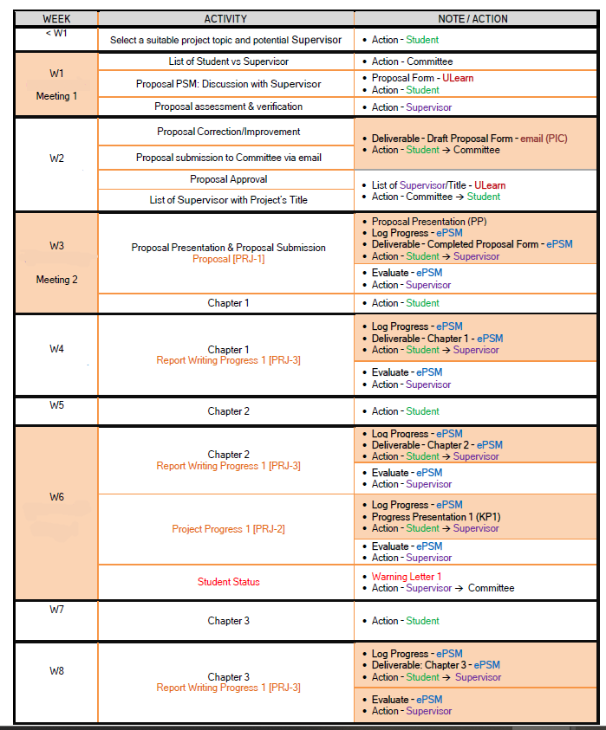
5.0 FYP 1 – Milestones

Slide 18
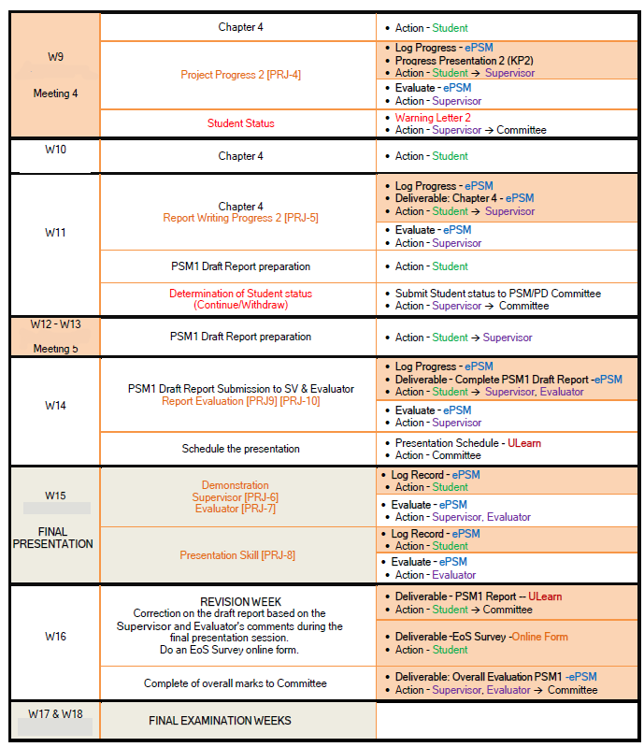
5.0 FYP 1 – Milestones

Slide 19
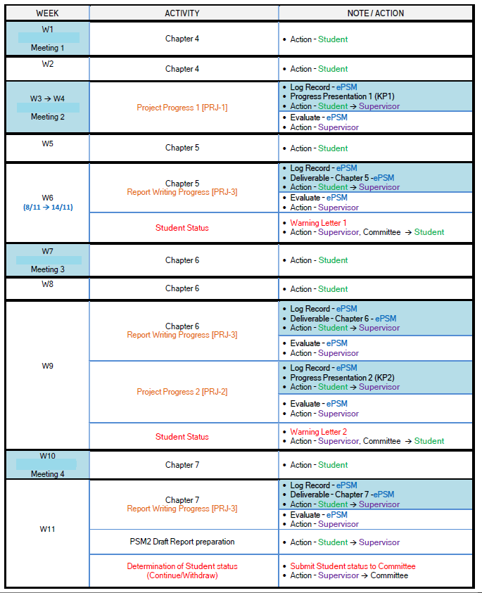
5.2 FYP 2 Milestones

Slide 20
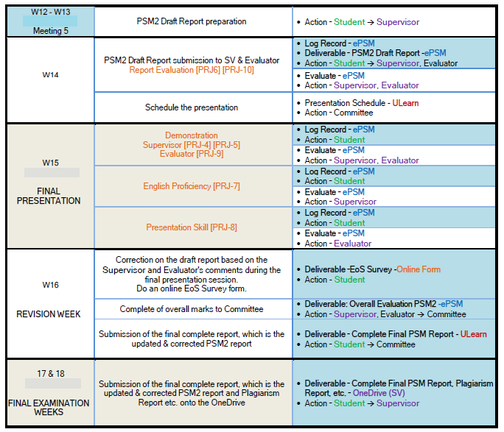
5.2 FYP 2 Milestones

Slide 21
6.0 Student’s responsibility-Approval
Selection of Title and Summary of the Project Proposal
Need to provide information related to the project according to the Literature Review
Selection of Supervisor
Student must propose the title and summary of the research proposal to the selected supervisor
Student is responsible to get approval

Slide 22
6.1 Student’s responsibility – HW & SW requirement
Students should list the needed hardware and software to conduct their research.
For example the number of required servers, workstations, PCs, firewalls etc
Type of operating system and software to be used
The number of routers, wireless etc (please provide the network design)

Slide 23
6.2 Student’s responsibility – Project implementation
Implementation method and location
Students should discuss with their supervisor and indicate in the proposal, the location of the study to be carried out.
If it is implemented outside UTeM or FTMK, student should get a letter of authorization from the relevant industry
Notify if the research need to be implemented in Security Laboratory and so on.

Slide 24
6.3 Student’s responsibility – Meeting your supervisor
Student are required to meet their supervisor for at least 5 times (5x) per semester.
If failed to do so, warning letter from supervisor will be issued in the following week:
Week 6 : First warning letter
Week 9: Second warning letter
FYP presentation will start at week 15

Slide 25
7.0 FYP Problems - Supervisor
Supervisor?
Busy (meeting, project, classes, etc)
How to solve it?
Make an appointment
Produce your Gant Chart
Follow your Gant Chart

Slide 26
7.1 FYP problems - Students
Do not have titles
Do not know what they are doing
Do not meet supervisors
Not serious / Take it easy
Try to get minimum passing marks from supervisor and evaluator.
Give a lot of reasons.
Do not know FYP standards

Slide 27
8.0 FYP Evaluation

Slide 28
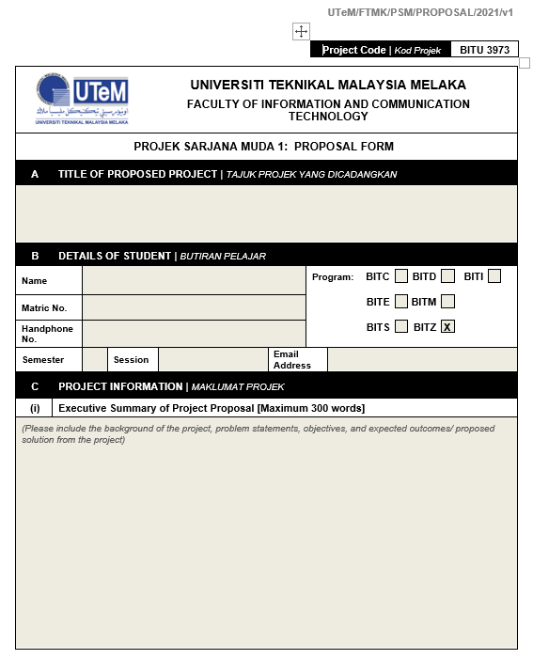
9.0 Proposal Form

Slide 29
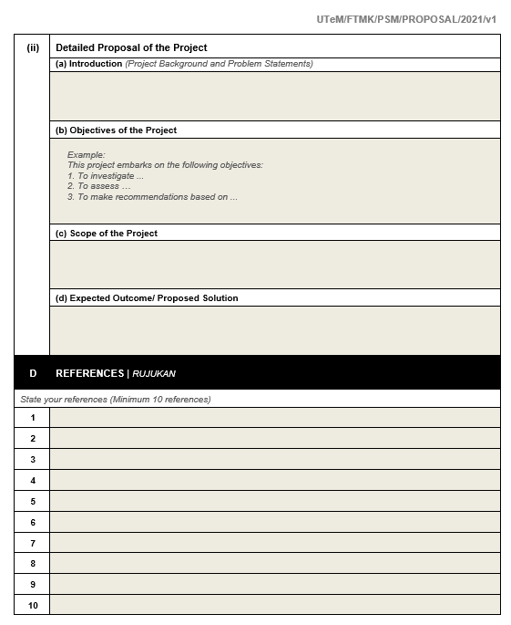
9.0 Proposal Form

Slide 30
10.0 FYP 1 & FYP 2 : Log report
Log Report
Students must write their FYP activities in their log report.
Students must write their discussion with the supervisor in their log report. The report requires date (as stated in milestones), and both student’s and supervisor’s signatures
Student must upload their log report in E-PSM

Slide 31
11.0 FYP Output
Output FYP 1 – Sem 2 (14 weeks) | Output FYP 2 – Short Sem (8 weeks)
Up to Implementation Complete prototype (min 70%) Complete analysis(min 70%) Complete System / tool (min 70%) | Product/Analysis Complete Testing and Result Analysis
Treatment Documentation (1-4) Type I: System/tool development literature review system design (DFD, Context Diagram if any) Algorithm Type II: Analysis literature review experimental / testbed design scripting design simulation design | Complete Report (chapter 1-7)

Slide 32
11.1 FYP Report format - General
Proposed | Description
General Content Chapter 1, 2, 3, 7 | Chapter 1: Introduction Intro Background PS, PQ, PO, scope, report organization, conclusion Chapter 2: Literature Review Intro, Related work/previous work critical review of current problem, justification proposed solution/further project conclusion Chapter 3: Project Methodology - Type I System: follow SE method - Type II Analysis: experimental, testbed, simulation, pilot test, survey - describe activities/steps/stages involved (milestones/gantt chart)

Slide 33
11.1 FYP Report format - General
Proposed | Description
General Content Chapter 1, 2, 3, 7 | Chapter 7: Project Conclusion Intro Project Summarization Project Contribution Project Limitation Future Works Conclusion

Slide 34
11.2 FYP Report format
- Specific
Proposed | Description
Specific content Chapter 4, 5, 6 | Type I: System Chapter 4: Analysis & Design follow SE e.g. DFD Chapter 5: Implementation follow SE Chapter 6: Testing method/step how to test and analyze follow SE Type II: Analysis Chapter 4: Design testbed design, experimental design, simulation design architecture (network - logical/physical) Chapter 5: Implementation eliminate step on h/w & s/w configuration Chapter 6: Testing & Analysis method/step how to test and analyze comparative analysis of the result

Slide 35
11.3 Literature Review References
Minimum Requirements for PSM Reports
10 related Conference Papers
2 related Journals Papers
Books
Websites
Minimum Requirements for PSM Proposal
3 related Papers (Conference or Journal)
Books
Websites
Websites classified as weak references

Slide 36
11.4 Report preparation – FYP 1
Format for report preparation is referring to “Panduan Penulisan Projek Sarjana Muda”
FYP 1
Report preparation is referring to the books guideline
Prepare at least until Chapter 4

Slide 37
11.4 Report preparation – FYP 2
FYP 2
Final report has been approved by supervisor and evaluator.
Final report has been signed by student and supervisor.
Student must upload Proposal report, FYP report, Turnitin report, log book, program in E-PSM and Ulearn.
Students can be failed if it does not meet the conditions set.

Slide 38
12.0 Prohibited Action
Copying previous FYP project either from:
current students or former students
other university students
the existing project on the market
To study without the approval of the agency or industry
Plagiarism of journal or paper or project
Hire or request someone to complete the project

Slide 39
12.1 Project TIPs
Get the first draft out as soon as possible
Don’t kill yourself trying to get perfection for the first time
Make sure you and your supervisor know what is going on
Write as you go along, not at the last minute

Slide 40
13.0 Lecturer’s expertise
No | Name | Expertise
1 | Prof. Dr. Shahrin bin Sahib @ Sahibuddin | Computer and Network Security, Software Security Testing, Computer Forensic
2 | Prof. Dr. Rabiah binti Ahmad | Information Security, Anti Cyberterrorism, Health Information Security and Management, Information Mining and Analysis, Risk Analysis, Health Informatics, Applied Cryptolography , Genetic Algorithm, Research Management
3 | Prof. Madya Dr. Mohd Faizal bin Abdollah | Intrusion Detection System, Computer and Network Security, Forensic, Mobile and Wireless Security, Network Management, Networking.
4 | Prof Madya Dr. Nor Azman bin Abu | Cryptography, Image Processing, Euclidean Travelling Salesman Problem
5 | Dr. Siti Rahayu bt. Selamat | Computer and Network Forensic, Computer and Network Security, Software Security Testing
6 | Dr. Robiah bt. Yusof | Computer and Network Security, Computer Forensic, Malware, Intrusion Detection System, Network Management.
7 | Mohammad Radzi bin Motsidi | QoS and QoE of Wireless Network, Computer Security, Network Performance Analysis
8 | Dr. Nurul Azma bt. Zakaria | IPv6 Migration, IoT, CPS, Embedded System Design, Computer System and Communication
9 | Dr. Shekh Faisal bin Abdul Latip | Design of symmetric-key primitives and security protocols, Cryptanalysis of cryptographic algorithms and security protocols, Side-channel analysis of cryptosystems.
10 | Dr S.M. Warusia Mohamed | Intrusion Detection System, Network Security And Data Mining
11 | Haniza bt. Nahar | Wireless Network Performance, Network Administration, Networking

Slide 41
13.0 Lecturer’s expertise
12 | Mohd Zaki bin Mas'ud | Malware Analysis, Computer Forensic And Network Security
13 | Dr. Nazrulazhar bin Bahaman | Ipv6 Migration, IoT, Computer Network
14 | Dr Norharyati bt. Harum | Signal Processing, Wireless Communication, IoT, Mobile Communication
15 | Dr Othman bin Mohd | Image Processing, Network Management, Remote Sensing, Geographic Information System, Management Information System
16 | Dr Zulkiflee bin Muslim | Ipv6 IDS, Feature Selection
17 | Dr Aslinda bt. Hassan | Network Performance Modelling And Analysis, Network Protocols In Ad Hoc Network, Network Programming Interfaces
18 | Khadijah bt. Wan Mohd Ghazali | Computer And Network Security
19 | Marliza bt. Ramly | Network Sensor Analysis
20 | Dr Mohd Fairuz Iskandar bin Othman | IT Governance And Management, IT Security, NeuroIS
21 | Mohd. Rizuan bin Baharon | Cryptography, Cloud Security, Privacy-preserving Data Aggregation

Slide 42
13.0 Lecturer’s expertise
23 | Muhammad Syahrul Azhar bin Sani | Network Performance Analysis, Routing In Mobile Ad Hoc Network
24 | Suhaimi bin Basrah | Information Theory, Watermarking, Multimedia Networking, Network Coding
25 | Dr Syahrulnaziah bt. Anawar | Network Routing And Management, Pervasive And Ubiquitous Computing, Human Centric Computing
26 | Dr. Wahidah bt. Md. Shah | P2P Network, Network Performance Analysis
27 | Dr. Zaheera binti Zainal Abidin | Network Management, Network Security, Wireless Security, Image Processing, Pattern Recognition And Biometrics.
28 | Zakiah bt. Ayop | Network Routing , Network Performance Analysis.
29 | Dr Zurina bt. Sa'aya | Information Retrieval, Recommender System.
30 | Dr Raihana Syahirah Abdullah | Network Securiry, Malware And Network Analysis
31 | Dr Nur Fadzilah Othman | Information Security, Privacy, Usable Security
32 | Irda Roslan | WLAN, Computer System and Communication

Slide 43
13.0 Lecturer’s expertise
33 | Erman Hamid | Network Performance Analysis, Routing In Mobile Ad Hoc Network
34 | Nor Azman Mat Ariff | Pattern Recognition And Network Management
35 | Ariff bin Idris | Wireless Network
36 | Mohd Najwan Khambari | Networking

Slide 44
14.1 Others - FYP Documents
Available in ULearn:
FYP Implementation Guidance (Panduan Perlaksanaan PSM)
Complete info about FYP execution for committee, supervisors and students.
FYP Writing Guidance (Panduan Penulisan PSM)
Complete info about content of FYP report and formatting.
Refer to BITC & BITZ section (for guidance on FYP contents)
Project Proposal Form

Slide 45

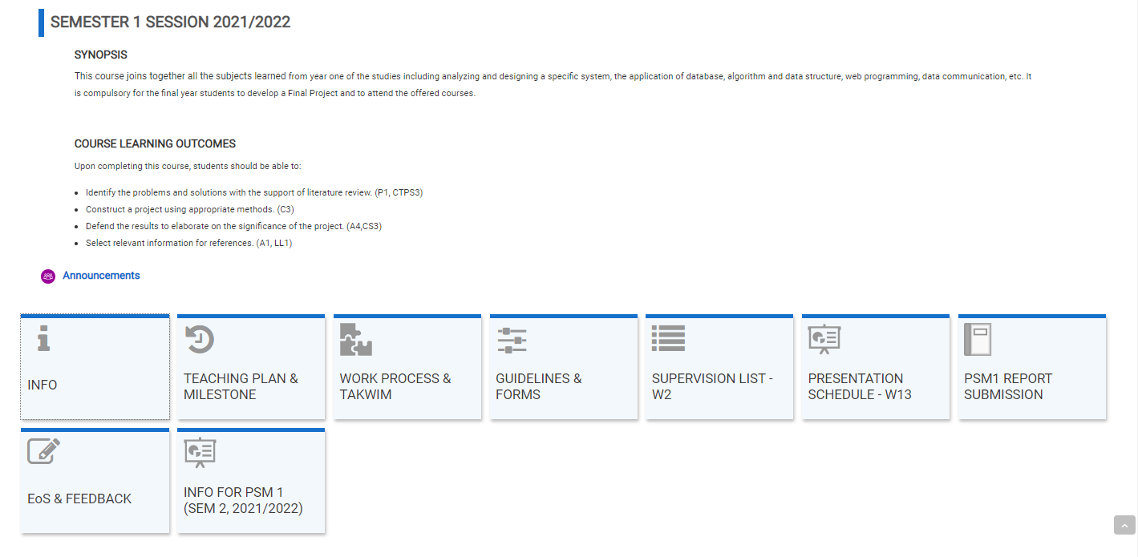
14.2 Others – Things to do now
ULearn
Enroll BITU 3973 Final Year Project 1 (FYP1/PSM1) course page
Get all documents related for BITC & BITZ

Slide 46
14.2 Others – Things to do now
Project Proposal FYP 1
Seek and engage with supervisor (SV)
Discuss feasible project with SV
Ask SV to sign the *form to confirm on the proposed project, then submit the hardcopy of the proposal form to FYP committtee (BITC/BITZ) by Week 1, Sem 2 2021/2022.
However, early discussion and draft proposal submission to supervisor and FYP Committee (before Sem 1 Break) is encouraged.
* Fill up project proposal form (download from course page)

Slide 47
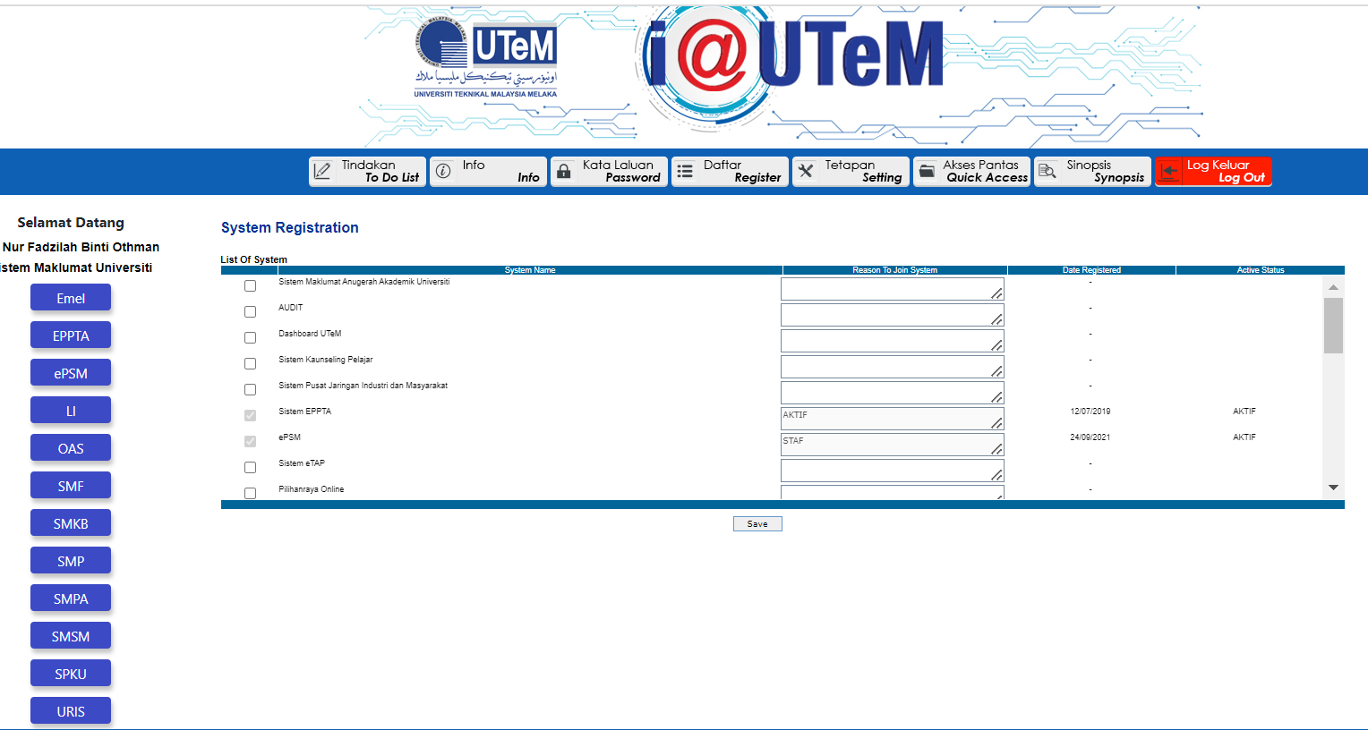
14.3 Others – E-PSM
Collection of documents related to FYP 1 & FYP 2 projects
Uploaded by students
Reviewed & commented by supervisors
Managed by the FYP committee
Available on the 1st week of Sem 2
https://pres.utem.edu.my/

Slide 48
14.4 Others– FYP Committee
Any queries/further info, please refer to:
FYP Committee, BITC
Dr. Zaheera binti Zainal Abidin : zaheera@utem.edu.my
FYP Committee, BITZ
Dr Nur Fadzilah binti Othman: fadzilah.othman@utem.edu.my
Your supervisor

Slide 49
References
Buku Panduan Akademik FTMK
Format Panduan Penulisan Laporan Projek Sarjana Muda FTMK
ULearn

Slide 50
Q & A

